Slide 1

GSNNJ
June 2024
Leadership SUMMIT

Slide 2
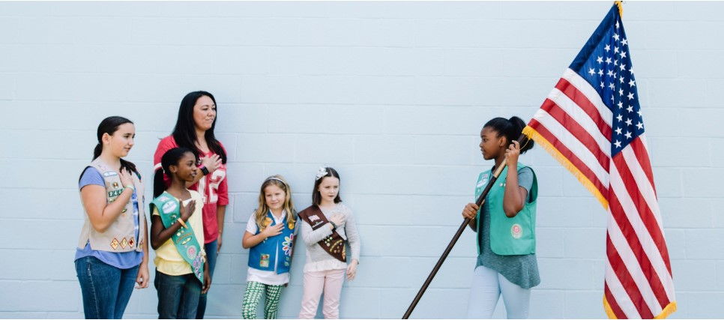
GIRL SCOUT PROMISE
On my honor, I will try:
To serve God and my country,
To help people at all times,
And to live by the Girl Scout Law.
GIRL SCOUT LAW
I will do my best to be
honest and fair,
friendly and helpful,
considerate and caring,
courageous and strong, and
responsible for what I say and do,
and to
respect myself and others,
respect authority
use resources wisely,
make the world a better place, and
be a sister to every Girl Scout.
PLEDGE OF ALLEGIANCE​
I pledge allegiance to the flag​
of the United States of America​
and to the Republic for which it stands​
one Nation, under God, indivisible​
with liberty and justice for all.

Slide 3
GSNNJ
Dates To Remember
Monday, August 19 Leadership SUMMIT

Slide 4
Product
Program

Slide 5

Product Program
2025 Girl Scout Cookie Program – “Embrace Possibility”
Girl Scouts – let us know what rewards you’d like to see next year. The mascot for the 2025 Girl Scout Cookie Program is a panda. Vote for your favorite rewards by June 30, 2024.
Click here to make your choices.

Slide 6
Business
Integration

Slide 7
Member Recruitment Campaigns
Each Service Unit has a “SU Name or town” Membership Recruitment Unit campaign.
Example: Morristown Member Recruitment Campaign
Recruitment Campaigns are used as a “holding place” while troops are being formed and for girls looking for a troop.
SU team members can direct potential volunteers and girls to register to this campaign.
The SU Campaign Admin role - monitors the recruitment campaign and will receive an auto email after a new member completes a membership purchase.
Would you or another SU Team member like to be added as the SU Campaign Admin, so you receive the emails containing contact information of the new member? If so, email customercare@gsnnj.org requesting to have the role added as SU Team volunteer.

Slide 8
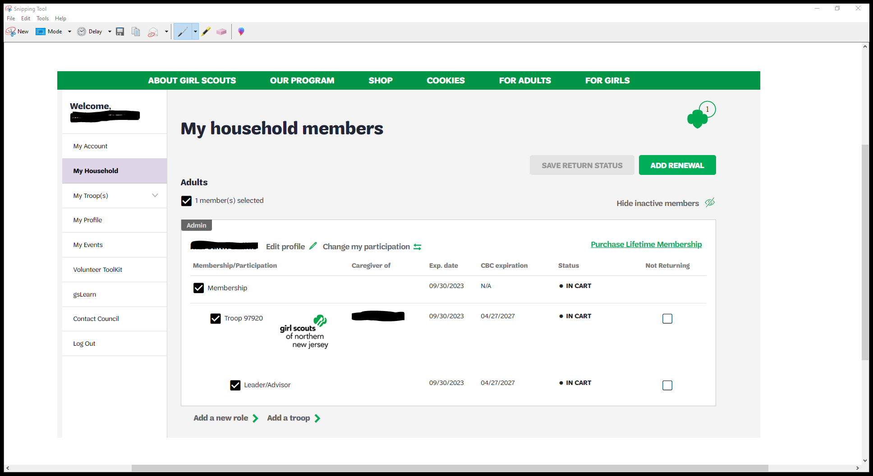
Renewal Instructions for 2025 Membership & Participation:
Do Not Click on Find a Troop
Log into your MyGS Account from www.gsnnj.org
Note: Username is the email address used to create your account. Forgot or need to update your email? Please send a request to customercare@gsnnj.org
Current 2024 Members:
Click Manage my Household members>
Check boxes for Membership + Troop/Role Participation for each of the individuals renewing.
  Please, do not check boxes under “Not Returning”
Click Add Renewal
Select 2025 Membership Year (10/1/2024-9/30/2025)
Click Review Cart
Check box to “I Agree to the Girl Scout Promise and Law”
Enter Payment

Slide 9
“Invite friends to join your troop”!
Leaders can send friends an email invitation to join their troop from My Troops.
(In VS 2.0 Troop leaders cannot register new girls directly)
Included in the email is a unique one-time use link that sends the individual to the troop in the Participation Catalog for Membership registration.
This unique link works only for the recipient you email it to, even if troop is not displayed or showing as having available spots.
The link is not sharable and will only be available to the caregiver it was sent to.
Instructions: Log in to your MyGS Account
Click on My Troop(s) tab.
Select your Troop, to view membership roster
Scroll to bottom of roster.
Click “Invite friends to join your troop”
Enter email address & “Submit Request.” A confirmation message will appear as “Success! Your invite has been sent.”
*Link is only valid for 1 hour.
Only send one individual invite at a time to the primary caregiver.

Slide 10

Business Integration
All girls who renew their membership by June 30, 2024 will receive a Renewal Patch and an Early Bird Patch!

Slide 11
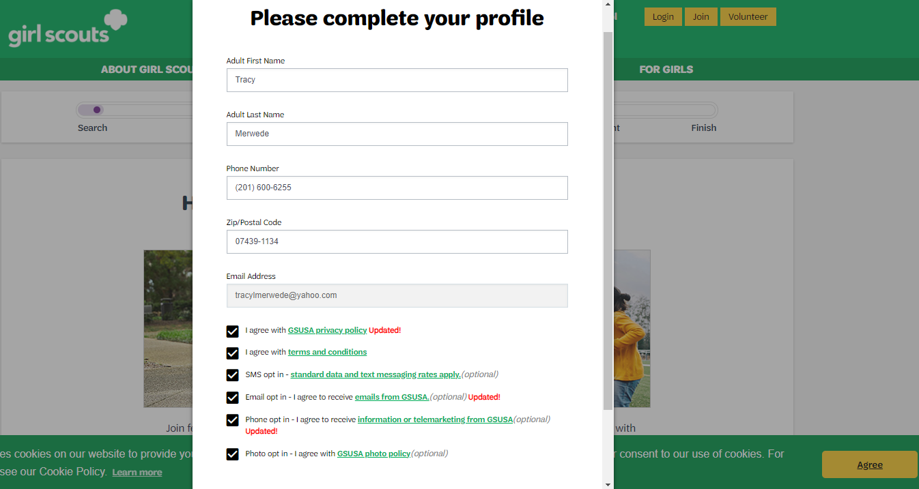
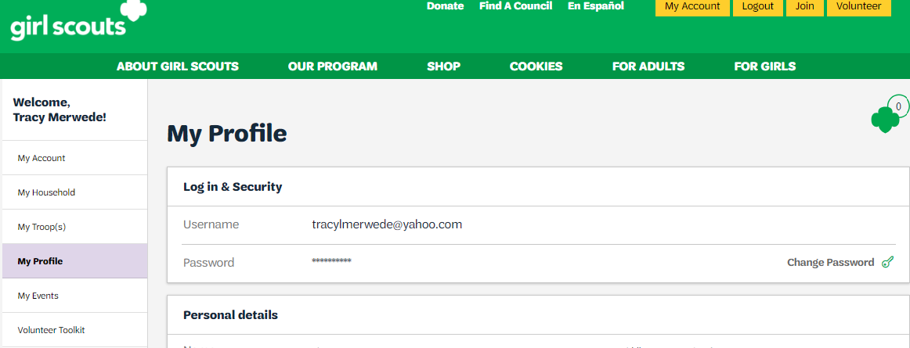
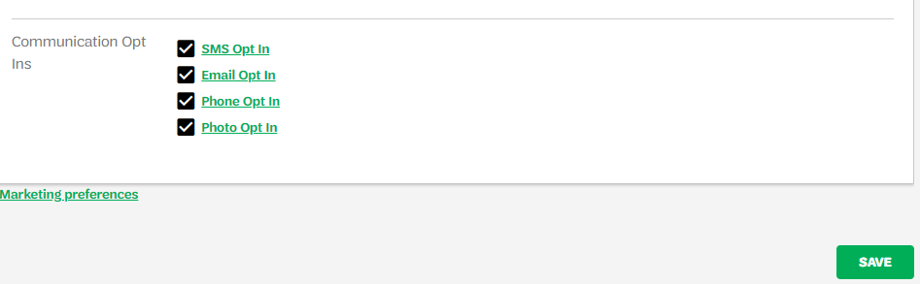
Business
Integration
Opt In for important notifications from GSNNJ.
Did you know that you need to opt in to receive GSNNJ updates?
When logging into your MyGS, there is a new pop-up box.
Please update your email, text and phone opt in preferences.
If the pop-up closes, you can update your
preferences by going to My Profile, scroll to the
bottom and opt in to receive important updates,
emails and text messages.

Slide 12

  Registration for New Girls
  for our 2025 Membership year begins on August 1
Membership Fees for 2024 - 2025
2025 Annual Girl Membership $40
2025 Annual Adult Membership $25

Slide 13
Important Dates:
GSNNJ Membership Dates | Dates
Early Bird Registration | April 1 – June 30, 2024
Extended Year Registration | April 1 – July 31, 2024
Young Alum LTM Registration for graduating 12th grade girls | After April 1, 2024

Slide 14
Troop
Support

Slide 15
Troop and Service Unit Finance Reports
Troop Finance Reports
The Troop Finance reports originally due June 30, 2024 , will now be due July 8th
and must include a copy of your May 2024 bank statement.
Troop Finance Reports are completed in the Finance Tab of the VTK.
Service Unit Finance Reports
The report form will be due before July 8, 2024
Trainings
Look for new Volunteer Training dates in August.

Slide 16
Volunteer Toolkit
July 1 – New Volunteers gain access.
July 15 – MY24 Year Archived. MY25 year opens.
•Year Plans moved to Past Years
•All Achievement & Attendance data cleared. Download ahead of time from the troop tab!
October 1 – Non-renewed members no longer have access. Renewing members are not affected.
•Finance Reports archived.

Slide 17
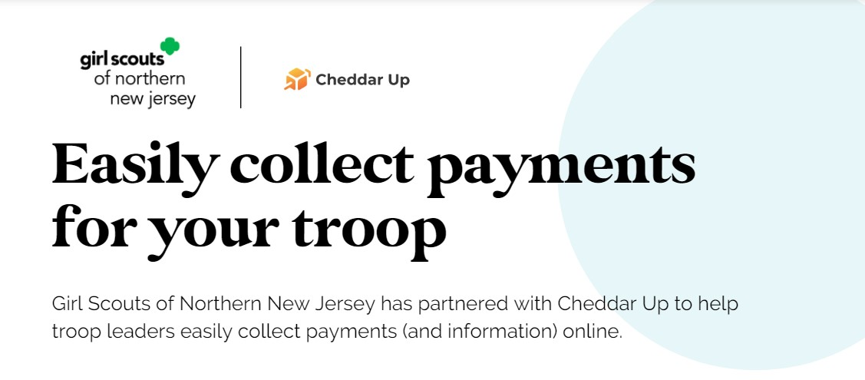
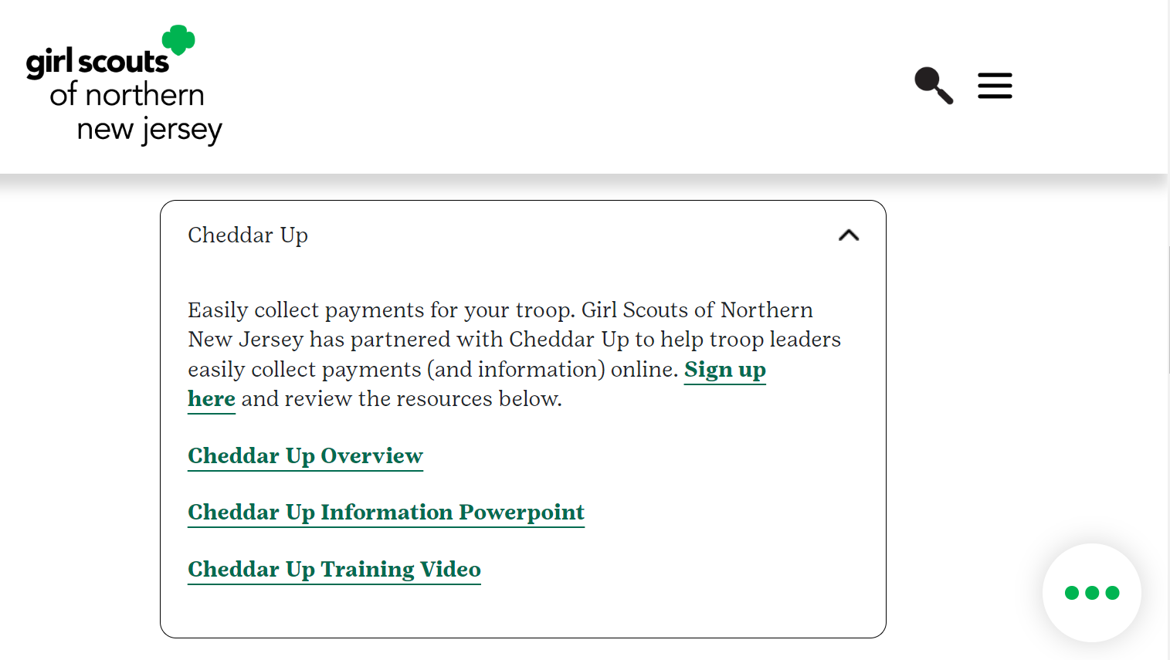
Cheddar Up Training/Information is available on our webpage www.gsnnj.org
under our Members/For Volunteers/Volunteer Training Section

Slide 18
Membership
Recruitment

Slide 19


The following Service Units have reached 100%
of their Girl Membership Goal!
Allendale
Boonton
Butler, Bloomingdale
Carlstadt/East Rutherford
Chatham
Cliffside Park, Fairview
Closter,Demarest,Haworth
Cresskill
Dover, Victory Gardens
East Hanover
Elmwood Park
Englewood
Florham Park
Glen Rock
Hackensack, Maywood, Rochelle Park, South Hackensack
Hackettstown/Allamuchy/
Great Meadows/Liberty
Hillsdale
Hopatcong,Glasser
Kinnelon
Lincoln Park
Long Hill(Gillette/ Stirling/
Millington)
Lyndhurst
Mendham
Mine Hill, Wharton
Montvale
Montville
Morris Plains
Morristown
Mount Olive
North Arlington
North Warren
Park Ridge
Passaic Valley
Pequannock/Pompton Plains
Ramsey
Randolph
Ridgewood
River Vale
Roxbury, Mount Arlington
Rutherford
Saddle River/Upper Saddle River
Vernon
Waldwick
Wallkill Valley
Wanaque, Haskell
West Milford/Hewitt/Newfoundland
Westwood, Twp of Washington
Woodcliff Lake
Wyckoff
Contact your Membership Recruitment Manager for your membership goal and recruitment materials

Slide 20

Recruitment plans are underway for new troops at all levels for the 2024/25 membership year.
Please contact us if you plan to attend any back-to-school nights, town days, county fairs, cultural celebrations or other community events.
We can help promote these and provide materials if needed.

Slide 21
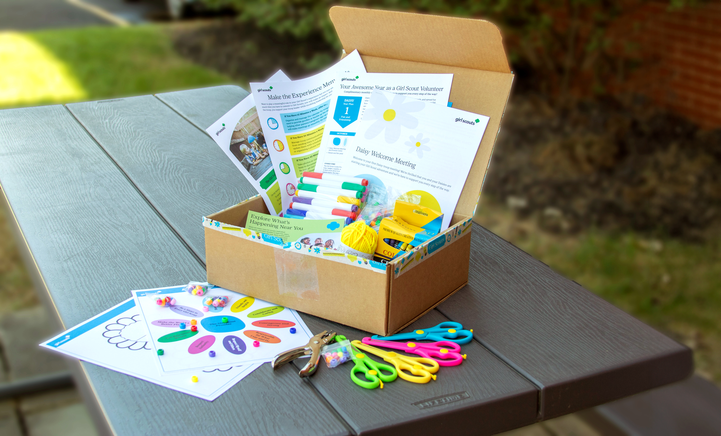
The first Girl Scout Experience Boxes for new Daisy troops start shipping in August.
Please see the FAQ’s page here: Girl Scout Experience Box for Daisies or contact us for a reminder of how new Daisy troops qualify for this complimentary resource.
Samples of the Girl Scout Experience Box are available for SUs to use at their own local recruitments.
Please contact your Membership Recruitment Manager to arrange pickup / drop off.

Slide 22

MLB Go Play kits will be shipped to qualifying Daisy troops on July 10. Troops will automatically be added to the shipment list once they have four registered Daisies in their troop.
We will be contacting new troops to remind them of the exact requirements and shipping deadline.
Please reach out to Claire Crowder ccrowder@gsnnj.org if you have any questions.
Editable recruitment flyers are available on the website here: Volunteer Essentials - Promoting Girl Scouts or you can contact your MRM to request flyers and any other materials you need to support your recruitment efforts.
Please look out for more information about Daisy Days in September and October.
Thank you for all you have done this past year, and we look forward to a great 2024/25 membership year!

Slide 23
Girl Scout Leadership
Experience

Slide 24


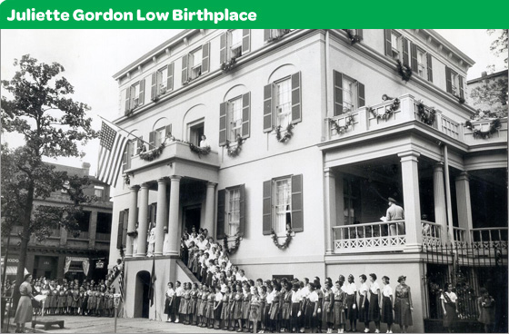
For more information email Program Director,
Anjole King at aking@gsnnj.org
For more Program Activities, dates and to register check our Events Calendar at: https://www.gsnnj.org/en/discover/activities/event-calendar.html
Ultimate S.T.E.A.M. at Urban Air
For: Girl Scout Brownies-Ambassadors/Families
Location: Urban Air, South Hackensack, NJ
Date: Fri., June 28, 2024
Time: 6:00 PM-8:00 PM
Fee: $29 per person
Hispanic Heritage Month Festival
For: Girl Scout Cadettes-Ambassadors
Location: Berkeley College, Woodland Park, NJ
Date: Sat. Sept. 28, 2024
Time: 11:00 AM-2:00 PM
Fee: $30 per person
Birthplace Bound
For: Girl Scout Cadettes-Ambassadors
Location: Savannah, GA
Dates: Tue., Nov. 5 to Sun., Nov. 10, 2024
Fee: $980 four-to-room/$1280 two-to-room

Slide 25

For more information email
Awards Program Manager,
Pat Christie at pchristie@gsnnj.org
For more Program Activities, dates and to register check our Events Calendar at: https://www.gsnnj.org/en/discover/activities/event-calendar.html
Bronze Award Workshop – for Adults
Location: Virtual via ZOOM
Time: 7:00 PM-9:00 PM
Dates: Wed., July 10, 2024
Mon., Aug. 5, 2024

Slide 26

For more information email
Awards Program Manager,
Pat Christie at pchristie@gsnnj.org
For more Program Activities, dates and to register check our Events Calendar at: https://www.gsnnj.org/en/discover/activities/event-calendar.html
Silver Quest – for Girl Scout Cadettes
Dates & Locations:
Sat., July 20, 2024 Jockey Hollow Camp, Mendham
Fri., July 26, 2024 Paramus Service Center
Fri., Aug. 9, 2024 Riverdale Service Center
Time: 10:00 AM-11:30 AM
Fee: $9 per girl
Silver Award Workshop – for Adults
Location: Virtual via ZOOM
Time: 7:15 PM-9:15 PM
Dates: Wed. July 27 & Tue., Aug. 20, 2024

Slide 27

For more information email
Awards Program Manager,
Pat Christie at pchristie@gsnnj.org
For more Program Activities, dates and to register check our Events Calendar at: https://www.gsnnj.org/en/discover/activities/event-calendar.html
Go Gold 1: The Introduction – for Girl Scout Seniors-Ambassadors
Location: Virtual via ZOOM
Time: 6:00 PM-7:00 PM
Dates: Wed., July 24 & Tue., Aug. 20, 2024
Go Gold 2: The Project – for Girl Scout Seniors-Ambassadors
Dates, Times & Locations:
Mon., July 8, 2024 7:00 PM-9:00 PM Paramus Service Center
Sat., July 20, 2024 12:30 PM-2:30 PM Jockey Hollow Camp, Mendham
Wed., Aug. 7, 2024 7:00 PM-9:00 PM Riverdale Service Center
Fee: $5 per person

Slide 28

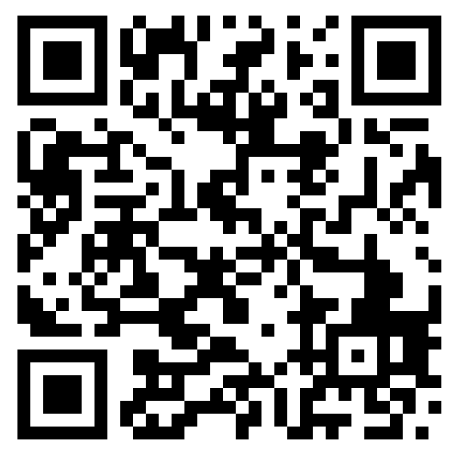
Bronze Award Submissions
Beginning May 2024 all Bronze Award final reporting
submissions will be completed through gsEvents.
(Final Report form no longer needed)
For more information email program@gsnnj.org
Use the QR code below to complete the online submission process.
This GSNNJ “event” is where Troop Leaders should enter their troop members who have earned the Bronze Award each month.
Please follow guidelines below:
Troop Leaders should enter the girls from the troop who have completed the Bronze Award.
When the “order” is completed, look for the “Print Receipt” button to print roster before logging out of your “my GS” account.
Bring the completed roster to a GSNNJ council service center shop to pick up the Bronze Award patches.

Slide 29
Fund
Development

Slide 30

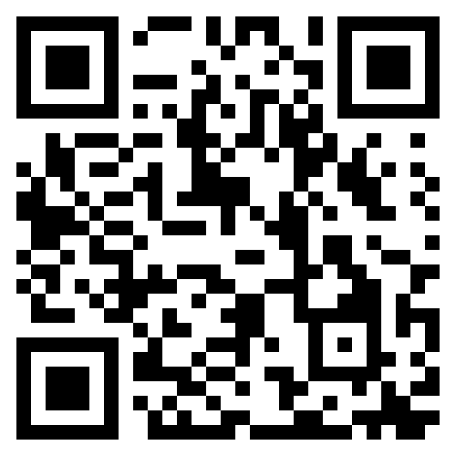
GEM Monthly Giving Program
Donors who give $10 or more through our Monthly Giving Program become members of our
GEM (Give Every Month) Society!
Benefits of Giving Monthly:
Monthly Gifts can provide memberships, program experiences, and so much more to the girls we serve every single month.
Your gifts are fully tax deductible and can be changed or cancelled at any time.
To become a GEM member, scan the QR code

Slide 31

Campership Appeal
Campership Financial Assistance Requests have DOUBLED this year!
Please scan the QR code below to donate today!

Slide 32
Thank you for all that you do for Girl Scouts!
Have a Great Summer!

