Slide 1
Cadette Think Like an Engineer Journey Box Girl Scouts of Northern New Jersey Adult Facilitators Guide

Slide 2
What is the difference between the Think Like an Engineer Journey and an Engineering badge?
The Think Like an Engineer Journey is a step above the Engineering badge because Girl Scouts work together to brainstorm solutions, make plans, and create prototypes to problems. Like real engineers, they will fail, and from failure; test, evaluate and redesign. They then complete the Journey by partaking in their own Take Action project, which requires Girl Scouts to identify areas that they would like to help within their communities, address the root of the issue and create a lasting effect.

Slide 3
Directions:
Adults you will use this guide to facilitate conversations and learning about engineering throughout this Journey. All pages of the Girl Guide line up to the pages of the Adult Facilitators Guide.

Slide 4
Part 1: Cadettes take on a hands-on challenge to engineer a model life vest that gives a model dog the ability to float using the problem-solving Design Thinking Process. Cadettes also find out about the Take Action project.
Part 2: Cadettes learn about bioinspiration as they work to engineer a model camp cabin inspired by nature. They also talk about what defines a community before brainstorming community problems that could lead to a sustainable Take Action project.
Part 3: Cadettes explore biomechanical engineering as they design, build, and test a prototype of a prosthetic elephant leg. They also review their Take Action ideas and choose one problem to address with their Take Action project.
Part 5: Cadettes use the Design Thinking Process to create their Take Action project and presentation.
Part 6: Cadettes share their Take Action project, celebrate what they've learned, and receive their Think Like an Engineer and Take Action awards.

Slide 5
Pre-Journey Discussion
Ask what an engineer does, define engineering and an engineer. Can the girls think of something that was engineered? On this Journey, you'll learn how to think like an engineer to solve problems. Engineers go through certain steps to solve problems. Those steps are called the Design Thinking Process. Does anyone know what the Design Thinking Process is? What steps do you think engineers take when solving a problem? Have girls share what they think the steps might be then share: First, engineers identify a problem that needs to be solved and investigate what has already been done. Next, they come up with different ideas for solutions. They pick one or more possible solutions and create their designs. Then, they test their designs and make improvements based on what they learned. Finally, engineers let other people know what they learned.

Slide 6
What kinds of work do Engineers do?
Here are some examples of how engineers help make the world a better place. Engineers use their knowledge, skills, and creativity to design, build, and maintain systems, structures, and technologies that improve our quality of life. From providing clean water and electricity to developing life-saving medical devices, engineering makes a tangible impact on the world around us.
Everyday Solutions: Engineers solve everyday problems by inventing and building things that can be used in the real world like bridges, buildings, planes. They create new and improved ways to make life easier and more efficient for everyone.
Agricultural Solutions: Engineers work with famers to design new machines, like improved irrigation (watering) systems, that help them grow and harvest crops faster and more efficiently.
Water Solutions: Engineers work around the world to build wells and other water systems, providing communities with access to clean water.
Manufacturing Solutions: Engineers cerate machines that speed up the production process.
Energy Solutions: Engineers create energy and light systems, like solar and wind power, to bring electricity to communities.
Solutions in Times of Disaster: Engineers design structures with disaster in mind. For example, following Hurricane Sandy in NYC, engineers evaluated their current systems and designed stronger infrastructure for cities like NYC to better weather against any future natural disasters.
Technological Solutions: Aerospace engineers design spaceships and satellites, giving astronauts and scientists the ability to learn more about our solar system and universe.

Slide 7
Glossary: Adults should ask girls what they think the words mean before they give full definitions
Engineers – people who use their creativity and knowledge of math and science to design technologies that solve problems. They create infrastructure like bridges, build clean water solutions like wells, design energy solutions like solar and wind power, build rockets that take aeronautics into space, and so much more.
Design Thinking Process – the steps engineers used to design technologies to solve problems. Engineers begin with identifying a problem that needs to be solved and investigating what has already been done. Next, engineers imagine different solutions and plan their designs. Then, they create and test their designs and make improvements based on the test results. Finally, engineers communicate their findings to others.
Form and function - the concept that the form (shape and size) of an object determines how well that object functions (does its job). For example, adding a rudder to a boat helps it move in specific directions.
Materials engineering - the field of engineering focused on designing materials with desired properties. Materials engineers use their understanding of the properties of different materials (such as metals, plastics, or woods) to design and improve technologies. Materials engineers explore the properties of different materials to help them choose which material will work best to solve the problem.
Prototype - a quick way to show your ideas to others or to try it out. It can be as simple as drawing or it can be made with everyday materials like cardboard, paper, string, rubber bands, etc.
Technology - Anything created by people to help solve a problem or meet a need. Technology can be things that require electricity, such as computers and phones, or non electronic products, such as pencils, paper, and water bottles.

Slide 8
Take Action Pause
Note to Adult: This quick activity is meant to help girls to start thinking about the communities they belong to and the issues that affect each community. This will give girls ideas for community problems they may want to address with a Take Action project.
For this Journey, you'll use the Design Thinking Process to Take Action. You'll work as one team to identify a problem, investigate why it happens and who it impacts, brainstorm lots of possible solutions for the problem, then choose one solution to plan out in more detail and bring it to life! After you create your Take Action Project, you'll share it with others, just like engineers!
Let's discuss community. What does it mean? What communities are you a part of? Are there any we are all a part of? What does it mean to be part of a community?

Slide 9
Model - A representation that helps us to understand an object or concept. Biomedical engineers sometimes use models of their subjects to help them engineer prototypes before they are ready to test their designs in the real world. User-centered design - When engineers practice user centered design, they involve their users at every stage of the design thinking process. By incorporating the user's needs, concerns, and feedback into their design, engineers are better able to create a product that solves their users problem and takes into account what's most important to them.
ACTIVITY 1 Glossary

Slide 10
ACTIVITY 1: Materials Needed
Materials needed:
1 sheet of foam (9 x 12 in.)
1 unopened can (12 oz.)
Scissors
Duct tape
Find the Dog Model Template on our web page, accessible by scanning the QR code.
Use the dog model template handout to trace the shapes onto a piece of foam. Cut out the foam pieces and attach them to the can with duct tape to create your model corgi.
Prepare Ahead: Fill a large plastic tub with water and place it in an area of the room that can get wet. This will be the testing station.

Slide 11
ACTIVITY 1 Design Challenge: Corgi Life Vest
Throughout this journey, you'll be challenged to design things that make the lives of animals and humans better. Today you've been hired by a family who has a corgi named Champ. Corgis have a hard time swimming because of their short legs. In preparation for an upcoming trip, the family would like a life vest made for Champ that would allow him to play with the children in the lake. You'll use your group's model to test the prototype of your life vests.
Reminder that you will need to provide your own unopened can for this activity.
For the activity:
Step 1 - Build the dog
Step 2 - Build the life vest
Step 3 - Test your life vest!

Slide 12
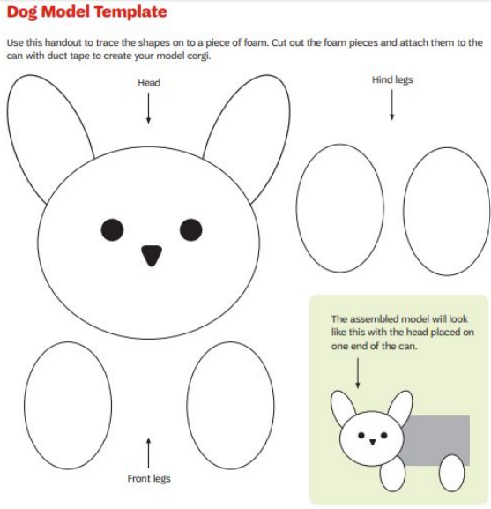
Activity 1: Model Dog Template

Slide 13
ACTIVITY 1: Model Dog Template
Find the Dog Model Template on our web page, accessible by scanning the QR code.
Use the dog model template handout to trace the shapes onto a piece of foam. Cut out the foam pieces and attach them to the can with duct tape to create your model corgi.
For the activity:
Step 1 - Build the dog
Step 2 - Build the life vest
Groups use the Dog Model Template to cut a corgi design from foam, attaching the foam pieces to the can with duct tape. They will use the models for testing in Design Challenge: Corgi Life Vest.

Slide 14
ACTIVITY 1: Criteria and Constraints
Criteria:
- Your life vest must allow the dog to float with its head above the water for 10 seconds.
- Your life vest must attach and detach from the model dog as quickly as possible.
Constraints:
- You can use up to 2 plastic bags, 2 sheets of foam, 3 rubber bands, 1 measuring tape, and 1 pair of scissors.
- The scissors and measuring tape cannot be used as a part of the life vest.
- You cannot test the life vest on the model dog until the designated testing time.
- You have 20 minutes to engineer your life vest pototype.
- After, you’ll have 20 minutes to test time, iterate, and improve the life vest.

Slide 15
ACTIVITY 1: Engineering Notes
Brainstorm Solutions, Plan, and Build a Prototype:
What is the design plan for your life vest? Write down ideas or draw plans for your design.
Test, Evaluate, and Redesign:
What materials or methods worked best for keeping Champ afloat?
What materials and methods worked best for quickly attaching and detaching the life vest to and from Champ?

Slide 16
Take Action Pause
Let's discuss the communities we listed before? Have you ever looked around your neighborhood or school and wondered how you could make a change for the better? This is the first step in a Take Action project. Here are some things to consider:
What are some issues or problems that impact our community? Who else is in our community?
What are some of their problems? Which of the problems could have an engineering or technological solution?
Which of these issues are you most interested in? Which do you most care about?
Once you have narrowed down the community you would like to focus on and what you would like to help improve or change, let's look at the problems you found in that community.
Write each problem you found and identify a root cause of that problem period use note cards to help separate the problems out and their root cause.
Take and spread them out and begin your process of deciding on which one you would like to focus on.
Look closely at each and narrow down what you feel you could be most effective and helpful with period if possible, think about sustainability this will help you when you begin to think about your Silver Award.
Do not worry about brainstorming a project yet. You just want to get those ideas flowing.

Slide 17
Activity 2: Glossary
Sustainability - coming up with a solution that lasts and continues to address the problem over time.
Sustainable solution - A solution that lasts. Sustainable solutions often address the root cause of an issue. Sustainable solutions create a difference for those impacted by a problem over the long term.
Bioinspiration - process of being inspired by living things. Bio inspired engineering is a new and growing field. It combines knowledge of engineering and natural sciences to develop technologies that are often more sustainable than those not inspired by nature. Many technologies are bioinspired such as Velcro strips inspired by plant burs or aerodynamic cars shaped like boxfish.

Slide 18
ACTIVITY 2 Materials Needed
Materials needed:
- ball of string
- roll of aluminum foil
- spray bottle
- construction paper
- stop watch
- scissors
- masking tape
- packaging tape
- sheet of cardboard 8x8 (can use the bottom of the box this journey came in)
- 2 plastic cups
- 2 sheets of construction paper
Reminder that you will need to provide your own fan for this activity

Slide 19
ACTIVITY 2: Criteria and Constraints
Criteria:
- Your model cabin must be inspired by at least one of the example animal shelters.
- Your model cabin must be water and wind resistant.
- Your model cabin must contain an entrance. The entrance should allow for a ¼ sheet of construction paper to easily be placed inside and taken out.
- Your model cabin must be at least 5” tall and 5” wide.
Constraints:
- You have 10 minutes to brainstorm and plan. After, you have 20 minutes to engineer.
- You may use up to 1 sheet of cardboard, 2 sheets of construction paper, 2 plastic cups, 12” each of masking and packaging tape, and any amount of aluminum foil and string.
- A measuring tape and scissors may be used as tools.

Slide 20
Activity 2: Design Challenge: Camp Cabin
Summer camp would like you to design their new cabins. They would like the cabins based upon, or inspired by, shelters created by animals. “Animal shelters” refers to the natural homes animals create and live in. It does not mean a place where stray animals are housed.
Goal for design challenge: Engineer a model camp cabin inspired by a shelter created by an animal.

Slide 21
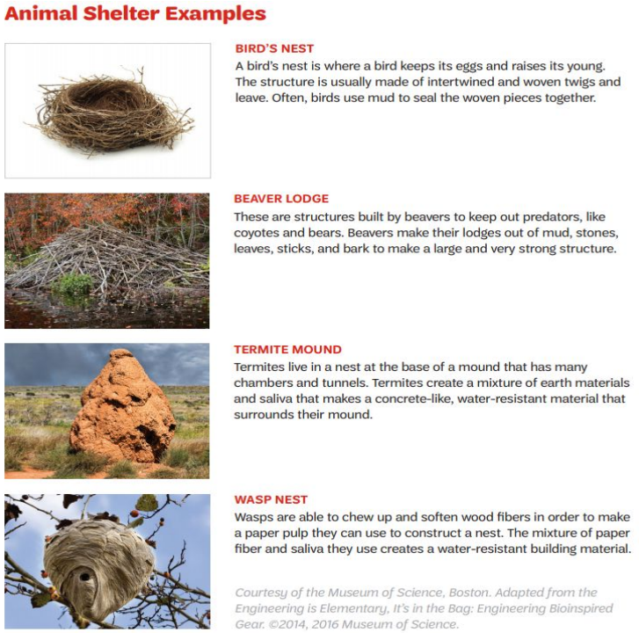
ACTIVITY 2: Examples of Animal Shelters
Brainstorm Solutions, Plan, and Build a Prototype
Which animal shelter(s) did you draw inspiration from? (Ex. birds, nest, beaver lodge, termite mound, wasp nest…)

Slide 22
ACTIVITY 2 Engineering Notes
Test, Evaluate, and Redesign
Is the cabin wind resistant? Place your cabin in front of the fan for 15 seconds. Start the fan on the lowest setting. If your cabin is not moved by the wind, turn the fan to a higher setting.
Is the cabin water resistant? Put a small sheet of construction paper inside of your cabin. Spray the top of the cabin with water 15 times, and check if the construction paper was able to stay dry.

Slide 23
Take Action Pause
Now that we have narrowed down the community you would like to focus on and the issue you want to work on, lets discuss more details about the Take Action project.
What problem or issue did we identify for the Take Action project?
How did we use the Design Thinking Process in our Take Action project?
How did we incorporate what's important to our community in our project?
How does the project benefit the community?
How is our Take Action project sustainable?
How does our Take Action project use engineering and technology?
What are some ways others can get involved to help solve the problem?

Slide 24
Empathy - the ability to understand how someone else feels. Biomedical engineers - people who use what they know about biology and mechanical engineering to solve problems related to health and safety. Biomedical engineers work on projects such as designing artificial limbs, joint replacements, and safety equipment, like helmets and life jackets. Prosthesis - An artificial device that takes the place of a missing body part. Prosthetic - A replacement of a body part (e.g. A prosthetic device such as an artificial leg).
ACTIVITY 3 Glossary

Slide 25
ACTIVITY 3 Materials Needed
- 1 roll of string
- 1 roll of packaging tape
- 1 ruler
- 2 plastic bags
- 2 sheets of felt
- 5 cardboard tubes 9”x1.5” (you can make these out of poster board)
- 5 rubber bands
- 1 measuring tape
- scissors
- duct tape

Slide 26
ACTIVITY 3 Design Challenge: Elephant Prosthetic
You are a biomedical engineer and have been asked to create a prosthetic device for an elephant! Use supplies to create a model leg and then test it on yourself. Use design process: design, build, test as many times as you need.
Mechanical and biomedical engineers both spend time developing design plans for products related to their field. Mechanical engineers concentrate more on product manufacturing and fixing technical issues while biomedical engineers can concentrate on several specialization areas that may emphasize medical research or developing methods to diagnose and treat medical conditions
A prosthetic device is something used to replace the function of a body part.
Goal: Engineer a model prosthetic elephant leg

Slide 27
ACTIVITY 3: Criteria
Criteria: the model leg must
1. Support their weight
2. Attach to the models actual leg at the knee
3. Stay together when used
4. Be comfortable to wear
Constraints:
- Keep in mind this cannot be tested on a real elephant, and the prosthetic is built to fit a human
- The ruler, measuring tape, and scissors cannot be used
- You can brainstorm ideas for 10 minutes and then build for 20 minutes

Slide 28
ACTIVITY 3 Engineering Notes
Testing the Prosthetic Leg:
Carefully place your knee onto the top of your model prosthetic elephant leg and secure any attachments you have designed. Hold on to a friend or a steady piece of furniture to prevent yourself from losing your balance. Follow the testing procedures below.
Function: Place your weight on the prosthetic leg. Does the device feel stable?
Comfort: place your weight on the prosthetic leg. Does the device feel comfortable?
Attachment: lift your leg off the ground. Does the device stay attached to your knee?
Durability: Walk in place for 5 steps. Does the device stay together?

Slide 29
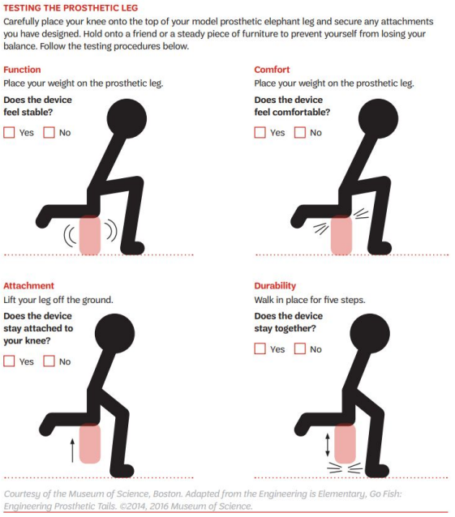
ACTIVITY 3: Testing the Prosthetic Leg

Slide 30
Good job completing the Think Like an Engineer activities! The next step is to do your Take Action Project. This will complete the Journey and you will have earned your Think Like an Engineer Badge!

Slide 31
Thank You
Girl Scouts of Northern New Jersey

