Slide 1
Cadette Think Like an Engineer Journey Box
Girl Scouts of Northern New Jersey
Girl Guide

Slide 2
What is the difference between the Think Like an Engineer Journey and an Engineering badge?
The Think Like an Engineer Journey is a step above the Engineering badge because Girl Scouts work together to brainstorm solutions, make plans, and create prototypes to problems. Like real engineers, they will fail, and from failure; test, evaluate and redesign. They then complete the Journey by partaking in their own Take Action project, which requires Girl Scouts to identify areas that they would like to help within their communities, address the root of the issue and create a lasting effect.

Slide 3
Directions:
Follow along with the 3 activities in these slides to get your Think Like an Engineer badge. Then you must complete your Take Action project in order to complete the Think Like an Engineer Journey.

Slide 4
In this journey we will do 3 design thinking activities:
Design and build prototypes of a life vest for a dog,
A model camp cabin inspired by nature,
And a prosthetic leg for an elephant.
These will help you prepare for your Take Action Project. Then you will plan your Take Action Project to help others.
You will earn the Think Like an Engineer badge when you complete the 3 projects and the Take Action badge when you complete the Take Action project.

Slide 5
Discussion:
What is an engineer? What does an engineer do?
Can you think of something that was engineered?
What steps do you think engineers take when solving a problem?

Slide 6
What kinds of work do Engineers do?
Think, pair, and share to discuss the phrases below and come up with examples of something that could be engineered in each area below. Then have a full group discussion.
Everyday Solutions:
Agricultural Solutions:
Water Solutions:
Manufacturing Solutions:
Energy Solutions:
Solutions in Times of Disaster:
Technological Solutions:

Slide 7
What do you think these words mean?
Think, pair, and share to discuss what you think these words mean. Then have a full group discussion.
Engineers
Design Thinking Process
Form and Function
Materials engineering
Prototype
Technology

Slide 8
Take Action Pause
What is a community? Write down ideas for communities you are part of. Where do each girl's communities overlap? Are there any communities that everyone is part of?

Slide 9
Model
User-centered design
What do you think these words mean?
ACTIVITY 1
Glossary

Slide 10
ACTIVITY 1:
Materials Needed
Materials needed:
1 sheet of foam (9 x 12 in.)
1 unopened can (12 oz.)
Scissors
Duct tape
Find the Dog Model Template on our web page, accessible by scanning the QR code.
Use the dog model template handout to trace the shapes onto a piece of foam. Cut out the foam pieces and attach them to the can with duct tape to create your model corgi.
Prepare Ahead: Fill a large plastic tub with water and place it in an area of the room that can get wet. This will be the testing station.

Slide 11
ACTIVITY 1
Design Challenge:
Corgi Life Vest
Throughout this journey, you'll be challenged to design things that make the lives of animals and humans better period today you've been hired by a family who has a corgi named Champ. Corgis have a hard time swimming because of their short legs. In preparation for an upcoming trip, the family would like a life vest made for Champ that would allow him to play with the children in the lake. You use your imagination to create a reason why your animal might need to be able to float. You'll use your group's model to test the prototype of your life vests.
Reminder that you will need to provide your own unopened can for this activity.

Slide 12
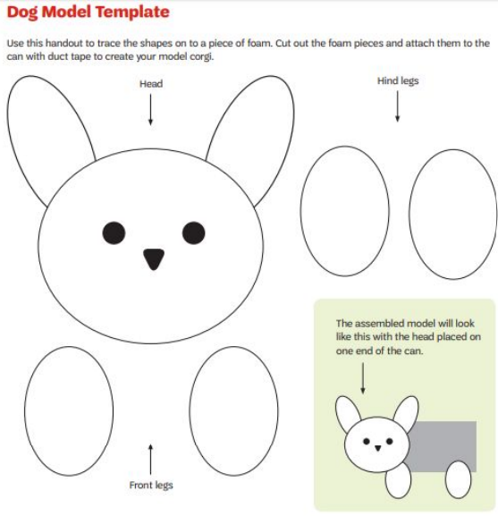
Activity 1:
Model Dog Template

Slide 13
ACTIVITY 1:
Model Dog Template
Find the Dog Model Template on our web page, accessible by scanning the QR code.
Use the dog model template handout to trace the shapes onto a piece of foam. Cut out the foam pieces and attach them to the can with duct tape to create your model corgi.
For the activity:
Step 1 - Build the dog
Step 2 - Build the life vest
Groups use the Dog Model Template to cut a corgi design from foam, attaching the foam pieces to the can with duct tape. They will use the models for testing in Design Challenge: Corgi Life Vest.

Slide 14
ACTIVITY 1:
Criteria and Constraints
Criteria:
- Your life vest must allow the dog to float with its head above the water for 10 seconds.
- Your life vest must attach and detach from the model dog as quickly as possible.
Constraints:
- You can use up to 2 plastic bags, 2 sheets of foam, 3 rubber bands, 1 measuring tape, and 1 pair of scissors.
- The scissors and measuring tape cannot be used as a part of the life vest.
- You cannot test the life vest on the model dog until the designated testing time.
- You have 20 minutes to engineer your life vest pototype.
- After, you’ll have 20 minutes to test time, iterate, and improve the life vest.

Slide 15
ACTIVITY 1:
Engineering Notes
Brainstorm Solutions, Plan, and Build a Prototype:
What is the design plan for your life vest? Write down ideas or draw plans for your design.
Test, Evaluate, and Redesign:
What materials or methods worked best for keeping Champ afloat?
What materials and methods worked best for quickly attaching and detaching the life vest to and from Champ?

Slide 16
Take Action Pause

Slide 17
Activity 2:
Glossary
What do you think these words mean?
Sustainability
Sustainable solution
Bioinspiration

Slide 18
ACTIVITY 2
Materials Needed
Materials needed:
- ball of string
- roll of aluminum foil
- spray bottle
- construction paper
- stop watch
- scissors
- masking tape
- packaging tape
- sheet of cardboard 8x8 (can use the bottom of the box this journey came in)
- 2 plastic cups
- 2 sheets of construction paper
Reminder that you will need to provide your own fan for this activity

Slide 19
ACTIVITY 2:
Criteria and Constraints
Criteria:
- Your model cabin must be inspired by at least one of the example animal shelters.
- Your model cabin must be water and wind resistant.
- Your model cabin must contain an entrance. The entrance should allow for a ¼ sheet of construction paper to easily be placed inside and taken out.
- Your model cabin must be at least 5” tall and 5” wide.
Constraints:
- You have 10 minutes to brainstorm and plan. After, you have 20 minutes to engineer.
- You may use up to 1 sheet of cardboard, 2 sheets of construction paper, 2 plastic cups, 12” each of masking and packaging tape, and any amount of aluminum foil and string.
- A measuring tape and scissors may be used as tools.

Slide 20
Activity 2:
Design Challenge:
Camp Cabin
Summer camp would like you to design their new cabins. They would like the cabins based upon, or inspired by, shelters created by animals. “Animal shelters” refers to the natural homes animals create and live in. It does not mean a place where stray animals are housed.
Goal for design challenge: Engineer a model camp cabin inspired by a shelter created by an animal.

Slide 21
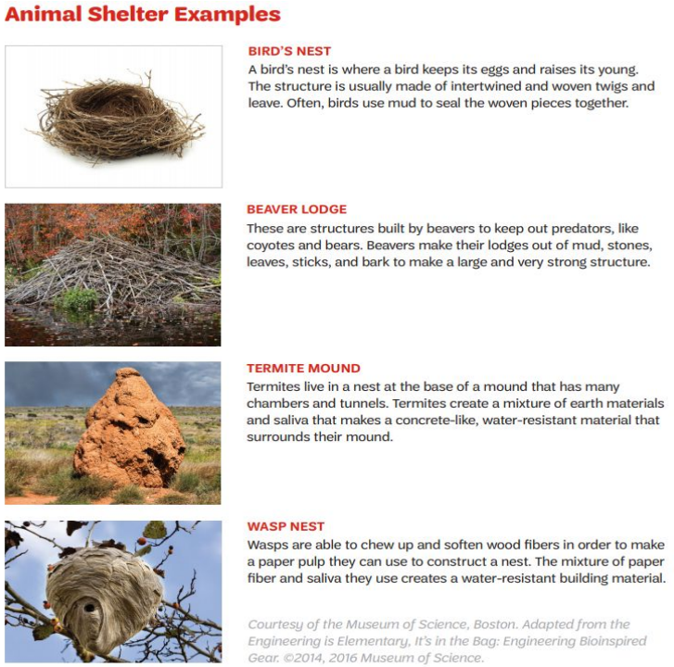
ACTIVITY 2:
Examples of Animal Shelters
Brainstorm Solutions, Plan, and Build a Prototype
Which animal shelter(s) did you draw inspiration from? (Ex. birds, nest, beaver lodge, termite mound, wasp nest…)

Slide 22
ACTIVITY 2
Engineering Notes
Test, Evaluate, and Redesign
Is the cabin wind resistant? Place your cabin in front of the fan for 15 seconds. Start the fan on the lowest setting. If your cabin is not moved by the wind, turn the fan to a higher setting.
Is the cabin water resistant? Put a small sheet of construction paper inside of your cabin. Spray the top of the cabin with water 15 times, and check if the construction paper was able to stay dry.

Slide 23
Take Action Pause

Slide 24
Empathy
Biomedical engineers
Prosthesis
Prosthetic
What do you think these words mean?
ACTIVITY 3
Glossary

Slide 25
ACTIVITY 3
Materials Needed
- 1 roll of string
- 1 roll of packaging tape
- 1 ruler
- 2 plastic bags
- 2 sheets of felt
- 5 cardboard tubes 9”x1.5” (you can make these out of poster board)
- 5 rubber bands
- 1 measuring tape
- scissors
- duct tape

Slide 26
ACTIVITY 3
Design Challenge:
Elephant Prosthetic
You are a biomedical engineer and have been asked to create a prosthetic device for an elephant! Use supplies to create a model leg and then test it on yourself. Use design process: design, build, test as many times as you need.
Mechanical and biomedical engineers both spend time developing design plans for products related to their field. Mechanical engineers concentrate more on product manufacturing and fixing technical issues while biomedical engineers can concentrate on several specialization areas that may emphasize medical research or developing methods to diagnose and treat medical conditions
A prosthetic device is something used to replace the function of a body part.
Goal: Engineer a model prosthetic elephant leg

Slide 27
ACTIVITY 3:
Criteria and Constraints
Criteria: the model leg must
1. Support their weight
2. Attach to the models actual leg at the knee
3. Stay together when used
4. Be comfortable
Constraints:

Slide 28
ACTIVITY 3
Engineering Notes
Testing the Prosthetic Leg:
Carefully place your knee onto the top of your model prosthetic elephant leg and secure any attachments you have designed. Hold on to a friend or a steady piece of furniture to prevent yourself from losing your balance. Follow the testing procedures below.
Function: Place your weight on the prosthetic leg. Does the device feel stable?
Comfort: place your weight on the prosthetic leg. Does the device feel comfortable?
Attachment: lift your leg off the ground. Does the device stay attached to your knee?
Durability: Walk in place for 5 steps. Does the device stay together?

Slide 29
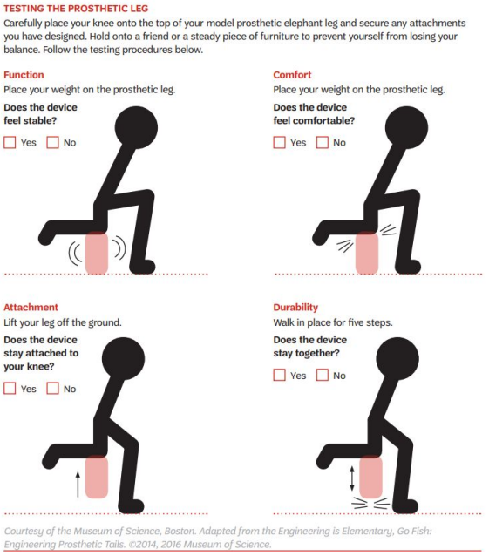
ACTIVITY 3:
Testing the Prosthetic Leg

Slide 30
Good job completing the Think Like an Engineer activities!
The next step is to do your Take Action Project.
This will complete the Journey and you will have earned your Think Like an Engineer Badge!

Slide 31
Thank You
Girl Scouts of Northern New Jersey

